Slide 1
CODE OF ETHICS
GROUP MEMBERS:
1.Meraj Zaman jim - 19-39705-1
2.Shahadat Hossain Pranta – 19-40000-1
3 IFFAT IBNUN IDRIS – 19-39878-1

Slide 2

Basic Concept of Engineering Ethics
Engineering ethics is the field of system of moral principles that apply to the practice of engineering

Slide 3

Require For Engineers
1.Honesty.
2.Impartiality.
3.Fairless.
4.Equity.
5.Loyalty.

Slide 4
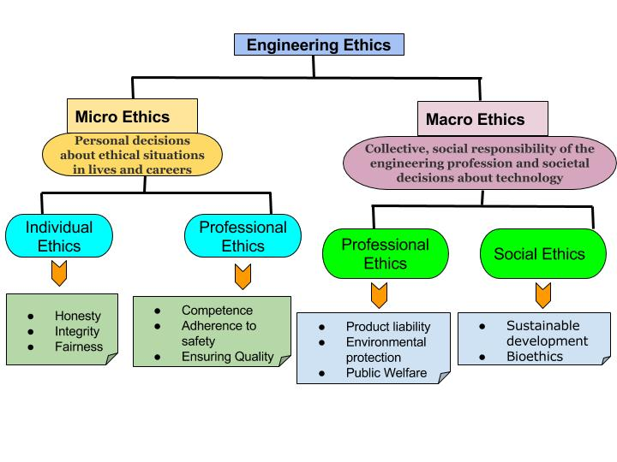

Slide 5
Codes of IEEE(Institute of Electrical and Electronics Engineer`s)
to hold paramount the safety, health, and welfare of the public, to strive to comply with ethical design sustainable development practices, and to disclose promptly factors that might endanger the public or the environment;
to avoid real or perceived conflicts of interest whenever possible, and to disclose them to affected parties when they do exist;
to be honest and realistic in stating claims or estimates based on available data;
to reject bribery in all its forms;
to improve the understanding by individuals and society of the capabilities and societal implications of conventional and emerging technologies, including intelligent systems;
to maintain and improve our technical competence and to undertake technological tasks for others only if qualified by training or experience, or after full disclosure of pertinent limitations;
to seek, accept, and offer honest criticism of technical work, to acknowledge and correct errors, and to credit properly the contributions of others;
to treat fairly all persons and to not engage in acts of discrimination based on race, religion, gender, disability, age, national origin, sexual orientation, gender identity, or gender expression;
to avoid injuring others, their property, reputation, or employment by false or malicious action;
to assist colleagues and co-workers in their professional development and to support them in following this code of ethics.

Slide 6
Codes of IISE(Institute of Industrial System Engineer`s)
The Fundamental Principles
Engineers uphold and advance the integrity, honor and dignity of the engineering profession by:
1. Using their knowledge and skill for the enhancement of human welfare;
2. Being honest and impartial, and serving with fidelity the public, their employers and clients;
3. Striving to increase the competence and prestige of the engineering profession; and
4. Supporting the professional and technical societies of their disciplines.
The Fundamental Canons
1. Engineers shall hold paramount the safety, health and welfare of the public in the performance of their professional duties.
2. Engineers shall perform services only in the areas of their competence.
3. Engineers shall issue public statements only in an objective and truthful manner.
4. Engineers shall act in professional matters for each employer or client as faithful agents or trustees, and shall avoid conflicts of interest.
5. Engineers shall build their professional reputation on the merit of their services and shall not compete unfairly with others.
6. Engineers shall associate only with reputable persons or organizations.
7. Engineers shall continue their professional development throughout their careers and shall provide opportunities for the professional development of those engineers under their supervision.

Slide 7
Comparison between IEEE and IISE
IEEE
IISE

Slide 8

Necessity of Code of Ethics

Slide 9
Conclusion

Slide 10
Thank you

